Slide 1
Introduction to Computer Hardware CMP 213 (Digital Computers)
Compiled by:
Egena Onu, Ph.D.

Slide 2
Course Content
Introduction to Digital Computers and systems
Logic Gates
Using Practical Logic Gates
Boolean Algebra
Boolean Operations and Expressions
Laws and Rules of Boolean Algebra
DeMorgans Theorem
Boolean Analysis of Logic Circuits
Standard and Canonical Forms
Karnaugh Maps
Combinational Logic Analysis

Slide 3
Course Administration
2 hours lecture per week
2 hours lab per week
15% Lab
15% CA
10% Attendance
60% Exams

Slide 4
Objectives
Explain Digital computer
Understand components of a digital computer
Basic knowledge of the relationship between numbers and digital computers.

Slide 5
Digital Computers
A digital computer is any class of device that is capable of solving problems by processing information in discrete forms.
A digital computer can also be seen as any programmable electronic device that processes numbers and words at enormous speed.
Digital computers process information by manipulating words and symbols according logical rules.
In our society today, digital computers are used to so many activities such as:
Controlling spacecrafts
Factories
Warehouses
Healthcare systems
Telecommunications
Banks
Household
Etc.

Slide 6
Components of a Digital Computer
The digital computer is made up of:
Central Processing Unit (CPU)
Memory
Input and Output (I/O) devices

Slide 7
Central Processing Unit (CPU)
The CPU, also called the “processor” is the unit that does all the processing in a computer.
This unit of the computer retrieves and executes instructions.
The CPU is an integrated circuit that performs the calculations that runs a computer.
The CPU performs
Arithmetical
Logical
Input/output
Instructions that are passed from an operating system.

Slide 8
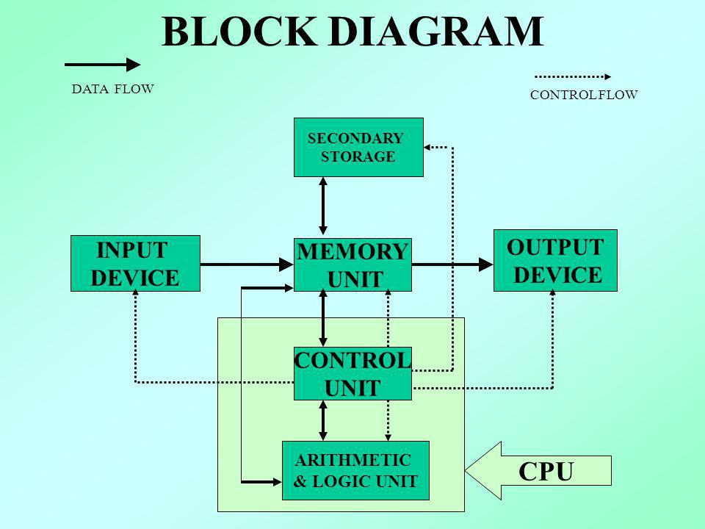
Components of a Digital Computers
Diagrammatically, the CPU is presented as:

Slide 9
Central Processing Unit (CPU)
The CPU can be clocked at up to 80MHz.
By clocking at 80MHz means that it can execute one instruction every 12.5 ns.
The CPU is capable of multiplying a 32-bit integer by a 16-bit integer in one cycle and a 32-bit integer by a 32-bit integer in 2 cycles.
There is no floating point unit in a CPU so this form of operation is carried out by software algorithms therefore making floating point operations much slower than integer math.
The CPU is made up of three essential components (transistors) that work together in processing digital data:
Control Unit (CU)
Arithmetic and Logic Unit (ALU)
Registers

Slide 10
Central Processing Unit (CPU)
Arithmetic and Logic Unit (ALU)
The ALU is a digital circuit (integrated circuit) used to perform arithmetic and logic operations.
ALU represents the fundamental building block of the CPU in any computer.
Modern CPUs contain very powerful and complex ALUs.

Slide 11
Central Processing Unit (CPU)
Arithmetic and Logic Unit (ALU)
Examples of arithmetic operations carried out by ALU are:
Addition
Subtraction
Multiplication and
Division.
Examples of logic operations in ALU are:
AND, OR, NOT, etc.
When operations become more and more complex, ALU also become more complex and expensive and takes more space in the CPU and dissipates more heat.

Slide 12
Central Processing Unit (CPU)
Control Unit (CU)
The CU tells the ALU what operation to perform on data and the ALU stores the result in an output register.
The CU moves the data to the output devices.

Slide 13
Central Processing Unit (CPU)
Registers
Registers are special transistors that store data and instructions as they are been manipulated by the control unit and ALU.

Slide 14
Memory
Questions

